Slide 1
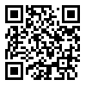
Adv. Biopharmaceutics
Dr. Mohammed Sabbar
College Of Pharmacy - Basrah
3rd Oct. 2018
http://bit.do/ex2aD

Slide 2
FORMULATION FACTORS AFFECTING DRUG PRODUCT PERFORMANCE Excipients

Slide 3
Examples:
1-Salicylic acid has pKa=3
Calculate the percent of drug available for absorption from empty stomach (pH=1.2) and duodenum (pH=6.8)
Drugs to be absorbed have to be in free form and in solution (molecules) except drugs absorbed by specific mechanism.
2-Metformin has pKa 2.8(acidic) and 11.2(basic)
has low bioavailability because of complexation with mucin of lumen.
3- Penicillin has two pKa’s that responsible for bioavailability of 40-45%.

Slide 4
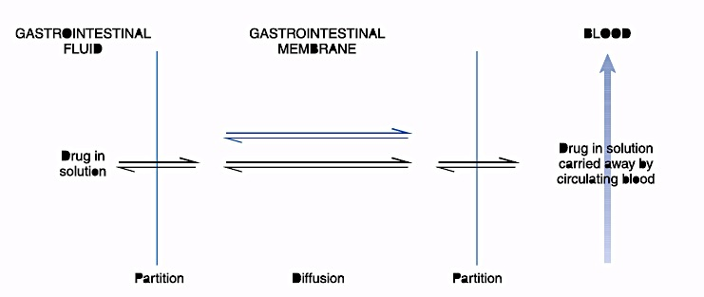

Slide 5
Mechanisms of drug absorption:
Passive diffusion mechanism (most drug- free form)
Active transport mechanism
Facilitated diffusion mechanism
Pinocytosis mechanism
Ion pair mechanism
Pores mechanism

Slide 6
Passive diffusion:
That governs by Fick’s law of diffusion (1st Fick’s law)
dq/dt = rate of diffusion
K=partition coefficient ??? Imp..
A=Surface area
H= Thickness of diffusion layer
Cs=Concentration of drug in GIT
Ct=concentration of drug in blood vessels.
Cs-Ct= concentration gradient or the difference that responsible for diffusion of drug (deriving force), Ct mostly very low (distribution and large volume of blood). Therefore Cs-Ct can be replaced by Cs.

Slide 7
Acidic drug

Slide 8
Thank you

